Slide 1
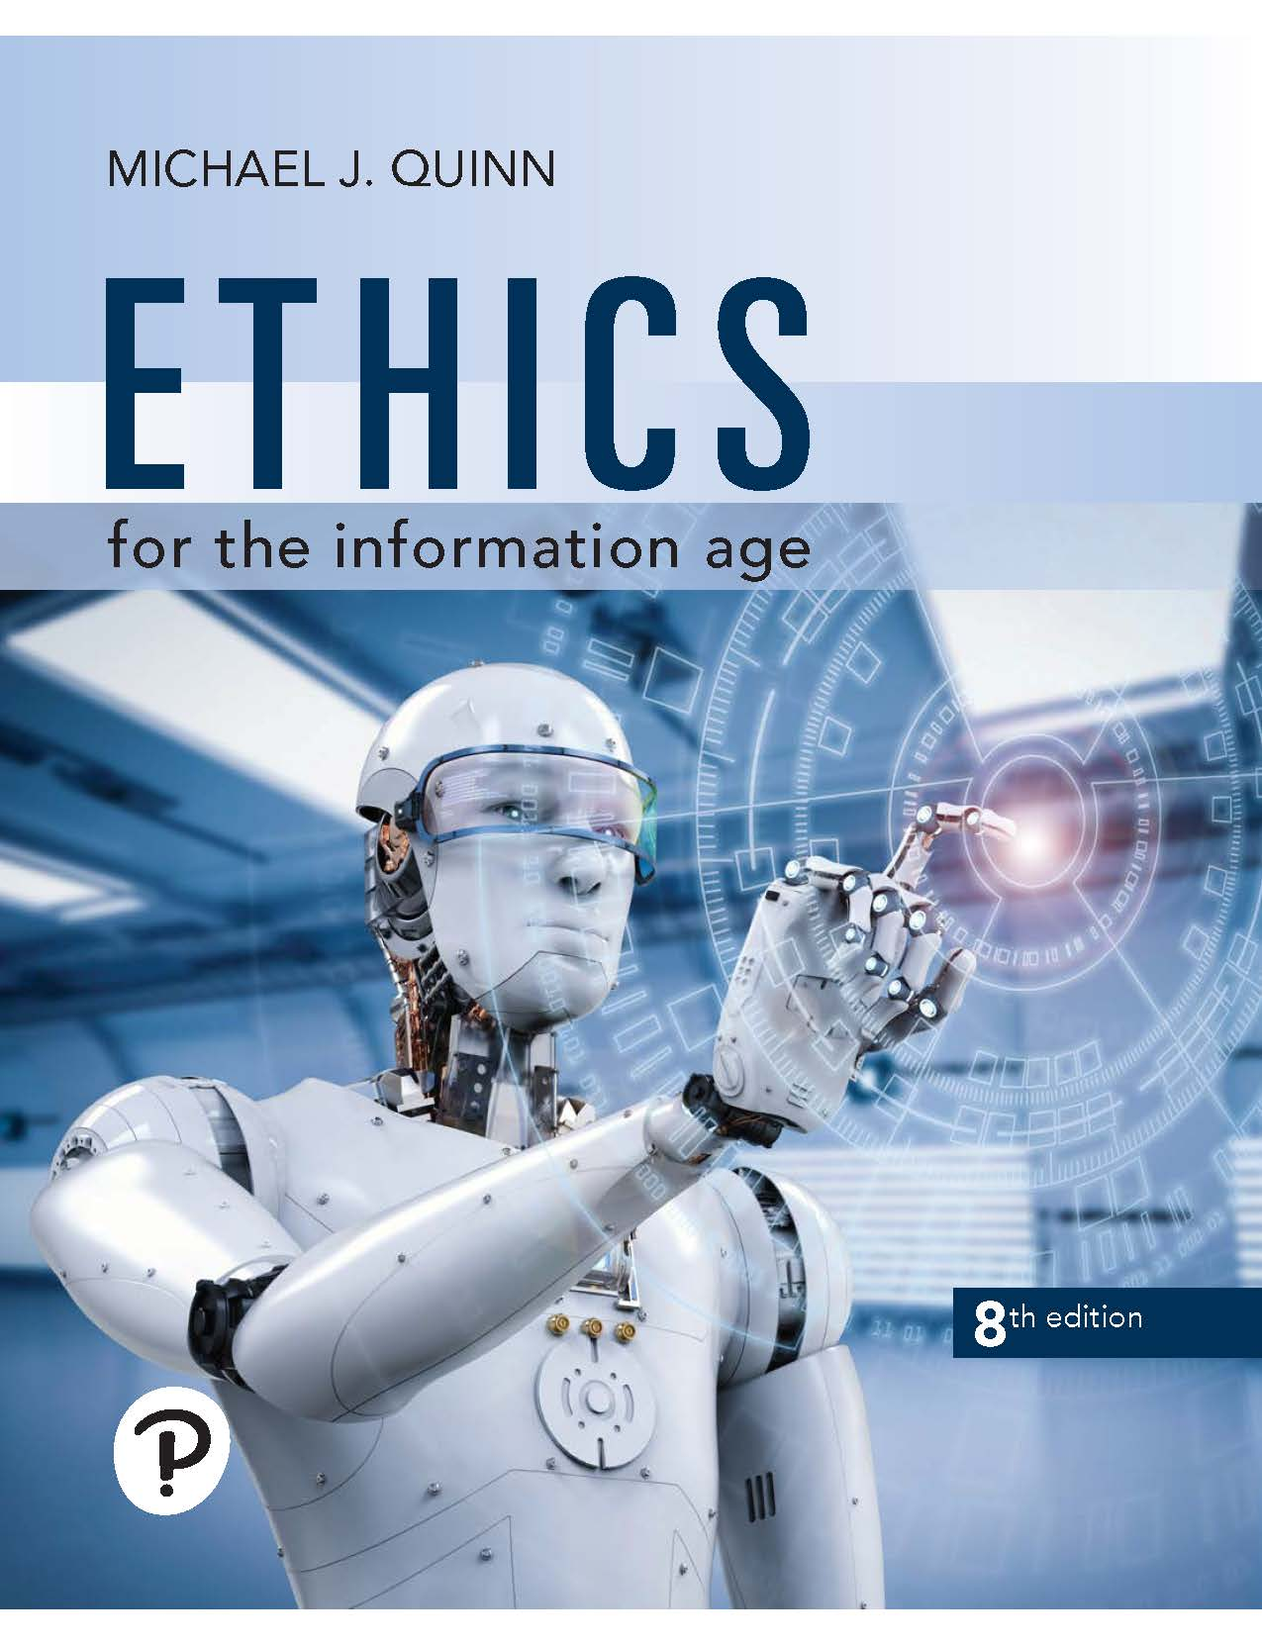
Ethics for the Information Age
Eighth Edition
Chapter 4
Intellectual Property
Copyright © 2020, 2017, 2015 Pearson Education, Inc. All Rights Reserved
Notes:
If this PowerPoint presentation contains mathematical equations, you may need to check that your computer has the following installed:
1) MathType Plugin
2) Math Player (free versions available)
3) NVDA Reader (free versions available)

Slide 2
Learning Objectives (1 of 2)
4.1 Introduction
4.2 Intellectual property rights
4.3 Protecting intellectual property
4.4 Fair use
4.5 Digital media

Slide 3
Learning Objectives (2 of 2)
4.6 Peer-to-peer networks and cyberlockers
4.7 Protections for software
4.8 Legitimacy of intellectual property protection for software
4.9 Open-source software
4.10 Creative Commons

Slide 4
4.1 Introduction

Slide 5
Information Technology Changing Intellectual Property Landscape
We benefit from access to high-quality television shows, music, movies, computer programs
Value of intellectual properties much greater than cost of media
Illegal copying pervasive
Internet allows copies to spread quickly and widely
In light of advances in information technology, how should we treat intellectual property?

Slide 6
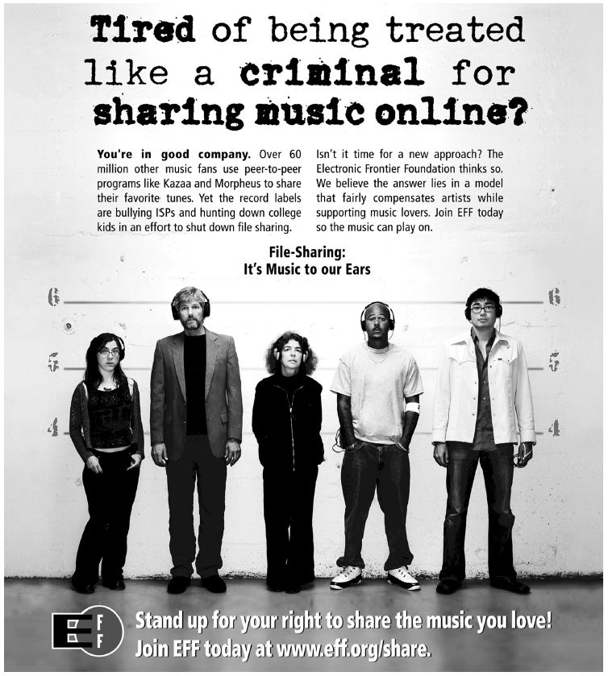
Copyright Laws and File Sharing
The Electronic Frontier Foundation is advocating a reform of the copyright laws in the United States. (Electronic Frontier Foundation)

Slide 7
4.2 Intellectual Property Rights

Slide 8
What Is Intellectual Property?
Definition*: I P refers to creations of the mind
Inventions
Literary and artistic works
Symbols, names, images used in commerce
Intellectual property
physical manifestation
Does right to own property extend to intellectual property?
* World Intellectual Property Organization

Slide 9
Property Rights
Locke: The Second Treatise of Government
People have a right…
to property in their own person
to their own labor
to things which they remove from Nature through their labor
As long as…
nobody claims more property than they can use
after someone removes something from common state, there is plenty left over

Slide 10
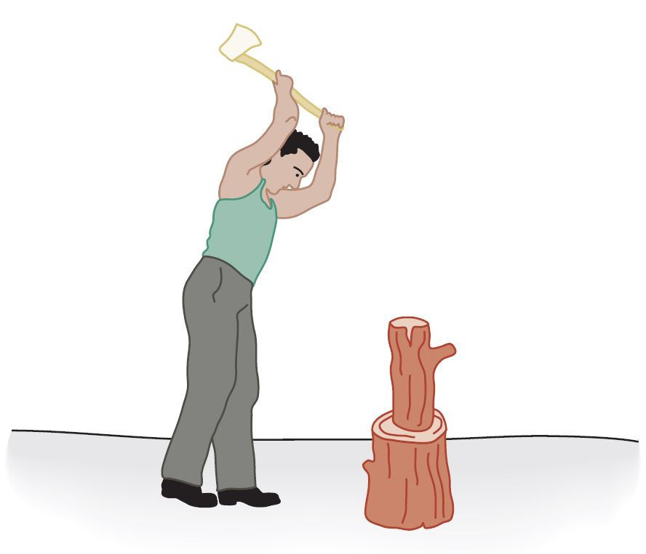
Locke’s Notion of Property Rights
According to John Locke, people have a natural right to the things they have removed from Nature through their own labor.

Slide 11
Expanding the Argument to Intellectual Property
Writing a play akin to making a belt buckle
Making a belt buckle
Mine ore
Smelt it down
Cast it
Writing a play
“Mine” words from English language
“Smelt” them into prose
“Cast” them into a complete play

Slide 12
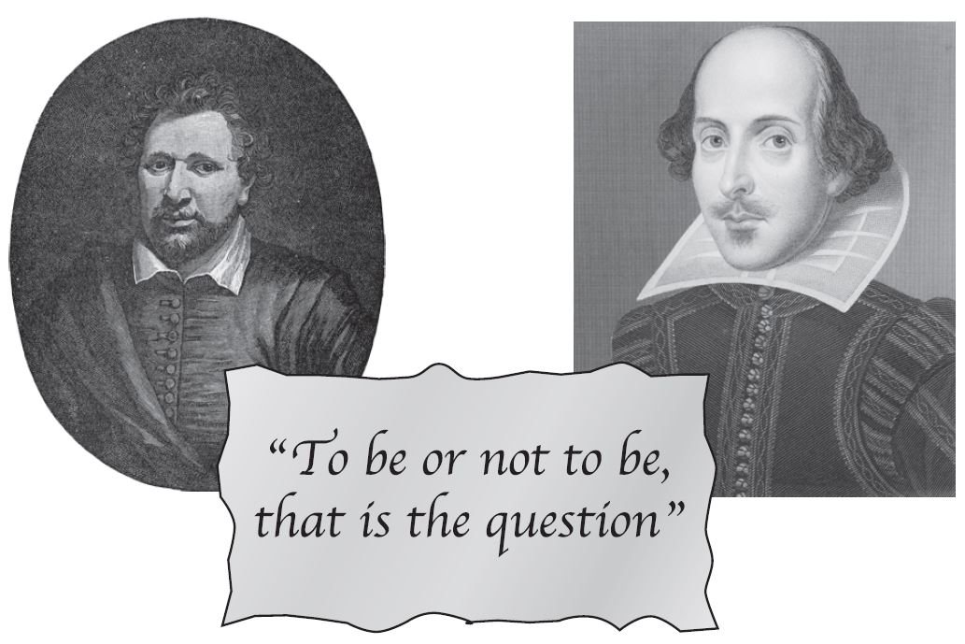
Analogy Is Imperfect
If Ben Jonson and William Shakespeare simultaneously write down Hamlet, who owns it?
If Ben “steals” the play from Will, both have it
These paradoxes weaken the argument for a natural right to intellectual property
(Ben Jonson: Walker Art Library/Alamy; Shakespeare: Classic Image/Alamy)

Slide 13
Benefits of Intellectual Property Protection
Some people are altruistic; some are not
Allure of wealth can be an incentive for speculative work
Authors of U S Constitution recognized benefits to limited intellectual property protection

Slide 14
Limits to Intellectual Property Protection
Giving creators rights to their inventions stimulates creativity
Society benefits most when inventions in public domain
U S Congress has struck compromise by giving authors and inventors rights for a limited time

Slide 15
Prices Fall When Works Become Public Domain
Artist | Work | Previous Rental Fee | Year Became Public Domain | Purchase Price
Ravel | Daphnis et Chloe Suite no. 1 | $450.00 | 1987 | $155.00
Ravel | Mother Goose Suite | 540.00 | 1988 | 70.00
Ravel | Daphnis et Chloe Suite no. 2 | 540.00 | 1989 | 265.00
Griffes | The White Peacock | 335.00 | 1993 | 42.00
Puccini | O Mio Babbino Caro | 252.00 | 1994 | 26.00
Respighi | Fountains of Rome | 441.00 | 1994 | 140.00
Ravel | Le Tombeau de Couperin | 510.00 | 1995 | 86.00
Respighi | Ancient Aires and Dances Suite no. 1 | 441.00 | 1996 | 85.00
Elgar | Cello Concerto | 550.00 | 1997 | 140.00
Holst | The Planets | 815.00 | 1997 | 300.00
Ravel | Alborada Del Gracioso | 360.00 | 1999 | 105.00
Table from “Letter to The Honorable Senator Spencer Abraham,” by Randolph P. Luck from Luck’s Music Library. (Copyright © 1996 by Randolph P. Luck. Reprinted with permission.)

Slide 16
4.3 Protecting Intellectual Property

Slide 17
Trade Secret
Confidential piece of intellectual property that gives company a competitive advantage
Never expires
Not appropriate for all intellectual properties
Reverse engineering allowed
May be compromised when employees leave firm

Slide 18
Trademark, Service Mark
Trademark: Identifies goods
Service mark: Identifies services
Company can establish a “brand name”
Does not expire
If brand name becomes common noun, trademark may be lost
Companies advertise to protect their trademarks
Companies also protect trademarks by contacting those who misuse them

Slide 19
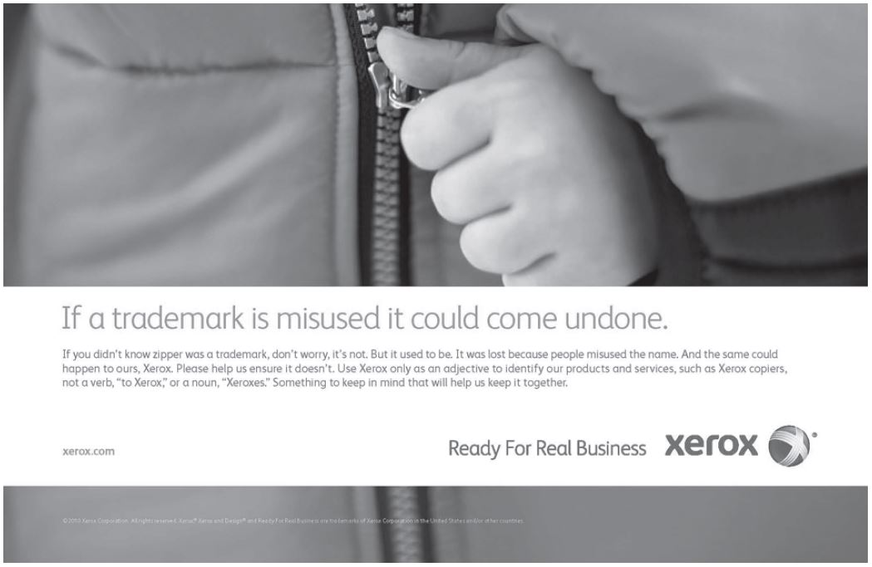
Trademarks and Service Marks
Xerox Corporation ran this advertisement as part of its campaign to protect its trademark. (Screenshot by Xerox. Copyright © 2012 by Xerox Corporation. All rights reserved. Reprinted with permission.)

Slide 20
Patent
A public document that provides detailed description of invention
Provides owner with exclusive right to the invention
Owner can prevent others from making, using, or selling invention for 20 years

Slide 21
Copyright
Provides owner of an original work five rights
Reproduction
Distribution
Public display
Public performance
Production of derivative works
Copyright-related industries represent 6% of U.S. gross domestic product (> $900 billion/ year)
Copyright protection has expanded greatly since 1790

Slide 22
Key Court Cases and Legislation
Gershwin Publishing v. Columbia Artists
Columbia Artists Management Inc. held liable for copyright infringements of community concert associations it supported
Davey Jones Locker
Richard Kenadek found guilty of violating copyrights of owners of software he posted on a computer bulletin board system
No Electronic Theft Act
Made it a criminal offense to reproduce or distribute more than $1,000 worth of copyrighted material in a six-month period

Slide 23
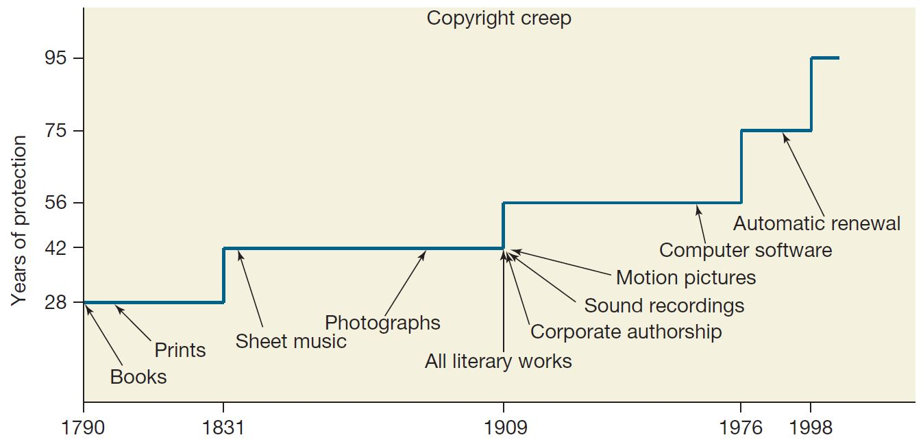
Copyright Creep (1 of 2)
Since the first Copyright Act was passed in 1790, both the length of copyright protection and the kinds of intellectual property that can be copyrighted have grown dramatically.

Slide 24
Copyright Creep (2 of 2)
Since 1790, protection for books extended from 28 years to 95 years or more
Some say latest extension done to prevent Disney characters from becoming public domain
Group of petitioners challenged the Copyright Term Extension Act of 1998, arguing Congress exceeded Constitutional power
U.S. Supreme Court ruling
C T E A does not create perpetual copyrights
C T E A is constitutional

Slide 25
Case Study: Database Guru
Rajiv employed at Felicity Software
Signed a confidentiality and proprietary rights agreement
Developed some database optimizations
Moved to Unrelated.com, supervises team developing database software
Realizes his optimizations would help team at Unrelated.com

Slide 26
Two alternatives for Rajiv
“Clean room” strategy
Provide team with publicly available information
Provide team with performance targets
Become personally involved
Ask team open-ended questions
Allow them to rediscover the optimizations he made at Felicity

Slide 27
Kantian Analysis
“Clean room” option
Rajiv does not violate agreement he signed
“You can share your expertise with others” is a rule that can be universalized
Morally right
“Personally involved” option
If he does not asking leading questions, O K
If he asks leading questions, he is disclosing information and violating agreement he signed
Breaking a contract = breaking a promise → wrong
Is it reasonable to think he can avoid asking leading questions?

Slide 28
Social Contract Theory Analysis
Similar to Kantian analysis
“Clean room” option
Rajiv helps team without violating an agreement
This is OK
“Personally involved” option
If he can avoid disclosing information, OK
If he gets impatient and discloses information, not OK

Slide 29
Act-Utilitarian Analysis (1 of 4)
Quantify consequences of each option in dollars
Time horizon: 5 years
Affected parties
Rajiv: Income over next five years
Unrelated.com
Lost income due to delay in releasing product
Expected costs associated with potential litigation

Slide 30
Act-Utilitarian Analysis (2 of 4)
“Clean room” option
Consequences for Rajib
Expects 10% raise, worth $15,000
Total worth $75,000 over five years
Unrelated.com
Six month delay costs the company six months’ revenue from its steady state
50,000 customers × $10/month/customer × 6 months = $3,000,000
No risk of litigation

Slide 31
Act-Utilitarian Analysis (3 of 4)
“Ask right questions” option
Unrelated.com
Three month delay costs the company six months’ revenue from its steady state, or $1,500,000
Litigation risk 6.25% and cost $5,000,000, so expected loss $5,000,000 × .0625 = $312,500
Rajiv
If no litigation, 15% raise, worth $112,500 over 5 years
If litigation, get fired, lose $750,000 over 5 years
Expected outcome: .9375 × $112,500 − .0625 × $750,000 = $58,594

Slide 32
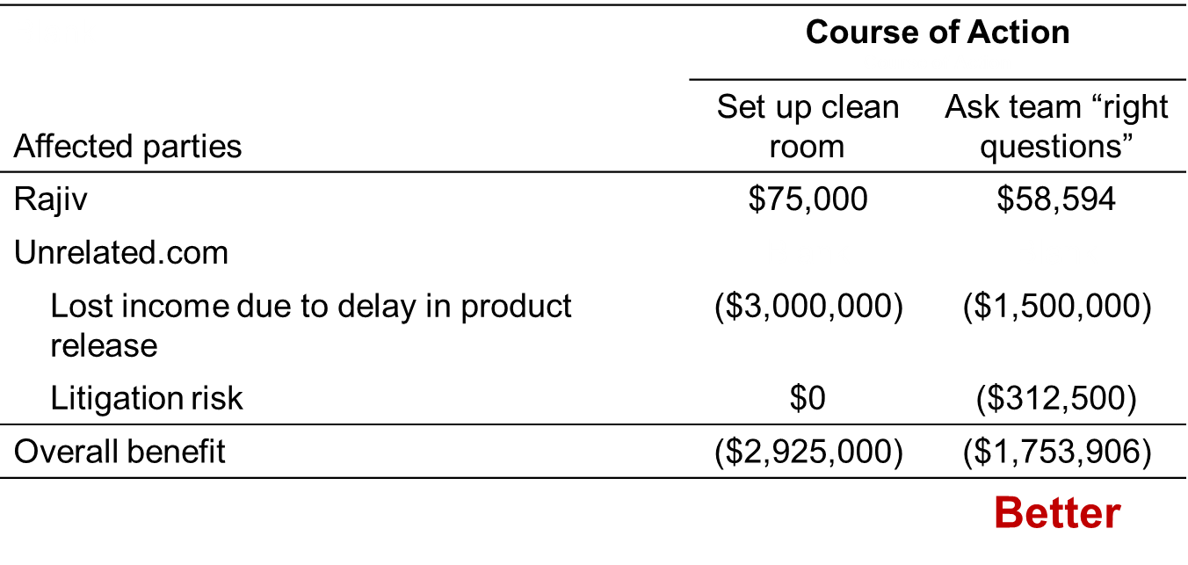
Act-Utilitarian Analysis (4 of 4)

Slide 33
Virtue Ethics Analysis
“Clean room” option
Gives team opportunity to create a system that meets performance requirements
Rajiv shares expertise, insists performance goals get met, characteristic of a good engineer and manager
“Personally involved” option
Working hard and sharing expertise are characteristic of good managers
Runs risk of violating confidentiality agreement, which is dishonest and not characteristic of good managers
Prudent choice is “clean room” option

Slide 34
Conclusion
“Clean room” option better option according to Kantianism, social contract theory, and virtue ethics
“Personally involved” option better according to act utilitarianism, though a more risk-averse analysis would have resulted in “clean room” option being preferred

Slide 35
4.4 Fair Use

Slide 36
Fair Use Concept
Sometimes legal to reproduce a copyrighted work without permission
Those circumstances called fair use
To judge fair use, courts consider four factors
Purpose and character of use
Nature of work
Amount of work being copied
Affect on market for work

Slide 37
Sony v. Universal City Studios
Sony introduced Betamax V C R (1975)
People started time shifting T V shows
Movie studios sued Sony for copyright infringements
U.S. Supreme Court ruled (5-4) that time shifting is fair use

Slide 38
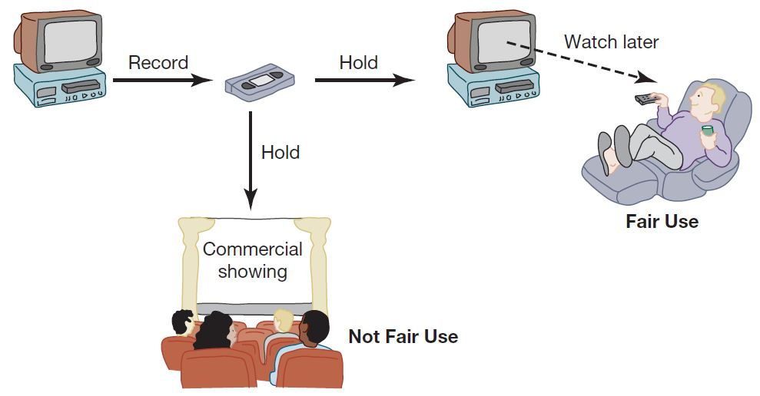
Time Shifting
The Supreme Court ruled that videotaping television broadcasts for private viewing at a later time is fair use of the copyrighted material. This practice is called time shifting. Using videotaped material for a commercial purpose is not considered fair use.

Slide 39
Digital Recording Technology
Copying from vinyl records to cassette tapes introduced hiss and distortions
Introduction of compact disc a boon for music industry
Cheaper to produce than vinyl records
Higher quality
Higher price
higher profits
But it’s possible to make a perfect copy of a C D

Slide 40
Audio Home Recording Act of 1992
Protects rights of consumers to make copies of analog or digital recordings for personal, noncommercial use
Backup copy
Give to family member
Digital audio recorders must incorporate Serial Copyright Management System (S C M S), so consumers can’t make a copy of a copy

Slide 41
R I A A v. Diamond Multimedia
M P3 compression allowed songs to be stored in 10% of the space, with little degradation
Diamond introduced Rio M P3 player (1998)
People started space shifting their music
R I A A started legal action against Diamond for violation of the Audio Home Recording Act
U.S. Court of Appeals, 9th Circuit, affirmed that space shifting is consistent with copyright law

Slide 42
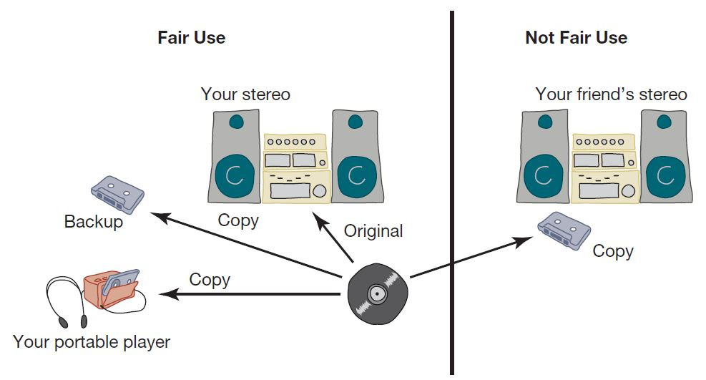
Space Shifting
Space shifting is the creation of a copy for backup purposes or for use in a portable device, and it is considered fair use. Making a copy for a friend is not considered fair use.

Slide 43
Kelly v. Arriba Soft
Kelly: photographer who maintained Web site with copyrighted photos
Arriba Soft: created search engine that returned thumbnail images
Kelly sued Arriba Soft for copyright infringement
U.S. Court of Appeals, 9th Circuit, affirmed that Arriba Soft’s use of Kelly’s images was “significantly transformative” and fair use

Slide 44
Authors Guild v. Google (1 of 3)
Google announced plan to scan millions of books held by several huge libraries, creating searchable database of all words
If public domain book, system returns P D F
If under copyright, user can see a few sentences; system provides links to libraries and online booksellers
Authors Guild and publishers sued Google for copyright infringement (copying books for commercial reasons)
Judge ruled in favor of Google and dismissed lawsuit

Slide 45
Authors Guild v. Google (2 of 3)
Judge: Google Books is a fair use of copyrighted works
Purpose and character:
Purpose is to create a massive index
Character is highly transformative
Precedent: Kelly v. Arriba Soft Corporation
Weighs in favor of fair use
Nature of work being scanned: mostly nonfiction
Weighs in favor of fair use

Slide 46
Authors Guild v. Google (3 of 3)
How much being scanned: entire work
Weighs against fair use
Effect on the market: stimulating book sales
Weighs in favor of fair use

Slide 47
Mashups
A versus B: instrumental track from one song + vocal track from another song
Audio collage: create new composition from dozens of audio fragments
Fair use? Lae suggests…
Audio collage: yes, because it is highly transformative
A versus B: no, unless “criticism, satire, or parody”

Slide 48
4.5 Digital Media

Slide 49
Digital Rights Management
Actions owners of intellectual property in digital form take to protect their rights
Approaches
Encrypt digital content
Mark digital content so devices can recognize content as copy-protected

Slide 50
Digital Millennium Copyright Act
First big revision of copyright law since 1976
Brought U.S. into compliance with Europe
Extended length of copyright
Extended copyright protection to music broadcast over Internet
Made it illegal for anyone to
Circumvent encryption schemes placed on digital media
Circumvent copy controls, even for fair use purposes

Slide 51
Secure Digital Music Initiative
Goals
Create copy-protected C Ds
Secure digital music downloads
Consortium of 200 companies developed “digital watermarking” scheme
Failed
Internet copying became huge before S D M I ready
Some S D M I sponsors were electronics companies
Digital watermarking encryption cracked

Slide 52
Sony B M G Music Entertainment Rootkit
Millions of audio C Ds shipped with Extended Copy Protection, a D R M system
Prevented users from
Ripping audio tracks into M P3 format
Making more than 3 backup copies
Relied upon Windows “rootkit” that hid files and processes; usually only hackers use rootkits
Huge public outcry once secret uncovered
Sony B M G stopped production and compensated consumers

Slide 53
Criticisms of Digital Rights Management
Any technological “fix” is bound to fail
D R M undermines fair use
D R M could reduce competition
Some schemes make anonymous access impossible

Slide 54
Online Music Stores Drop Digital Rights Management (1 of 2)
When iTunes Music Store opened in 2003, all music protected with a D R M scheme called FairPlay
FairPlay blocked users from freely exchanging purchased music
Songs couldn’t be played on more than 5 different computers
Songs couldn’t be copied onto C Ds more than 7 times
Songs purchased from iTunes Store wouldn’t play on non-Apple devices
D R M-protected music purchased from other online retailers couldn’t be played on iPod

Slide 55
Online Music Stores Drop Digital Rights Management (2 of 2)
Consumers complained about restrictions associated with D R M
European governments put pressure on Apple to license FairPlay or stop using D R M
In 2007 E M I began offering all its songs without D R M through the iTunes store
In 2008 Amazon reached an agreement with all four major music labels to sell D R M-free music
Apple followed suit in 2009

Slide 56
Microsoft Xbox One
Microsoft announced cloud-based gaming experience for Xbox One (June 2013)
User could play any game without disc in tray
Automatic software updates of every Xbox One
Controversial features of licensing arrangement
Disc could be shared only once
Second-hand market restricted
Xbox consoles would have to check in every 24 hours
Microsoft backtracked
No need to connect to Internet
Freedom to lend, rent, buy, sell discs
Disc must be in tray to play game

Slide 57
4.6 Peer-to-Peer Networks and Cyberlockers

Slide 58
Peer-to-Peer Networks
Peer-to-peer network
Transient network
Connects computers running same networking program
Computers can access files stored on each other’s hard drives
How P2P networks facilitate data exchange
Give each user access to data stored in many other computers
Support simultaneous file transfers among arbitrary pairs of computers
Allow users to identify systems with faster file exchange speeds

Slide 59
Cyberlockers
Also called file-hosting services or cloud storage services
Internet-based file-sharing services
Allow users to upload and download password-protected files
Support workgroup collaboration
Make sharing of copyrighted material easy

Slide 60
Napster
Peer-to-peer music exchange network
Began operation in 1999
Sued by R I A A for copyright violations
Courts ruled in favor of R I A A
Went off-line in July 2001
Re-emerged in 2003 as a subscription music service

Slide 61
FastTrack
Second-generation peer-to-peer network technology
Used by KaZaA and Grokster
Distributes index among large number of “super nodes”
Cannot be shut down as easily as Napster

Slide 62
R I A A Sued Grokster, Kazaa
April 2003: R I A A warned file swappers they could face legal penalties
R I A A subpoenaed Verizon for identities of people suspected of running supernodes
Judge ruled in favor of Verizon
September 2003: R I A A sued 261 individuals
December 2003: U.S. Court of Appeals ruled Verizon did not have to give customer names to R I A A

Slide 63
Huge Jury Judgments Reduced
Jammie Thomas-Rassert
Federal jury ordered her to pay $1.92 million
Damages reduced to $54,000
Joel Tenenbaum
Jury ordered him to pay $675,000
Judge reduced award to $67,500
Does R I A A have to prove someone actually copied the songs that people made available on Kazaa?
New York decision: No
Massachusetts, Arizona decisions: Yes

Slide 64
M G M v. Grokster
Entertainment industry interests sued Grokster and Stream Cast for the copyright infringements of their users
Lower courts
Ruled in favor of Grokster and StreamCast
Cited Sony v. Universal City Studios as a precedent
U.S. Supreme Court
Reversed the lower court ruling in June 2005
Proper precedent Gershwin Publishing v. Columbia Artists

Slide 65
BitTorrent
Broadband connections: download much faster than upload
BitTorrent speeds downloading
Files broken into pieces
Different pieces downloaded from different computers
Used for downloading large files
Computer programs
Television shows
Movies

Slide 66
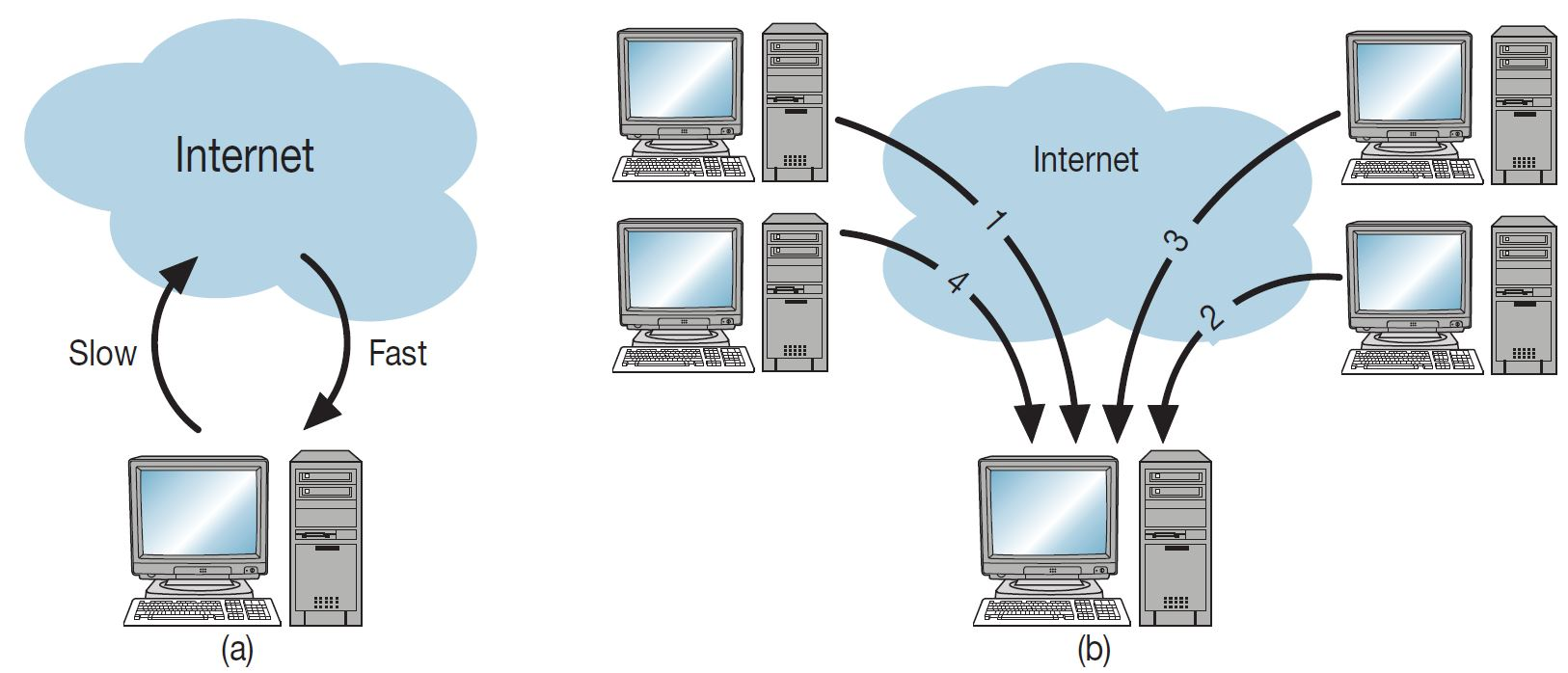
Concept Behind BitTorrent
(a) Broadband Internet connections provide higher speeds for downloading than for uploading. (b) BitTorrent reduces downloading times by enabling a computer to download different pieces of a file simultaneously from many different peers.

Slide 67
Legal Action Against the Pirate Bay (1 of 2)
The Pirate Bay started in Stockholm, Sweden
One of world’s biggest BitTorrent file-sharing sites
People download songs, movies, T V shows, etc.
After 2006 raid by police, popularity increased
In 2008 the International Federation of the Phonographic Industry sued four individuals connected with site

Slide 68
Legal Action Against the Pirate Bay (2 of 2)
Defendants said the Pirate Bay just a search engine
Found guilty; sentenced to prison and fined $6.5 million
Meanwhile, the Pirate Bay still operational
More than 150 proxy servers all over the world

Slide 69
P R O-I P Act
Gives federal law enforcement agencies right to seize domain names of sites facilitating copyright infringement
Operation In Our Sites (2010)
Seized domain names of 10 Web sites making available full-run movies
Seized several hundred more domain names over next 1 ½ years

Slide 70
Megaupload Shutdown
Megaupload a prominent cyberlocker
Based in Hong Kong
More than 180 million users
Once the world’s 13th most popular Web site
Founder, Kim Dotcom, lived in Auckland, New Zealand
2012 – Cooperation between law enforcement agencies in U S, New Zealand, and Hong Kong
Shut down Megaupload
Arrested Kim Dotcom for violating P R O-I P Act
Other cyberlockers responded by disabling sharing functionality

Slide 71
Legal Online Access to Entertainment (1 of 2)
Widespread piracy pressures companies to make “doing the right thing” as easy as “doing the wrong thing”
Major online stores provide safe, convenient downloads
Music without D R M
Consumer shift toward music streaming
Ad-supported model: listeners stream for free (100 M)
Subscription model: listeners pay monthly fee (40 M)

Slide 72
Legal Online Access to Entertainment (2 of 2)
Video streaming services: Netflix, Hulu Plus, Amazon Prime Instant Video, Sling (40% of U S homes)
Good news / bad news about music streaming
Good news: consumers will pay if cost reasonable
Bad news: Much lower revenues for publishers compared to selling C Ds

Slide 73
4.7 Protections for Software

Slide 74
Software Copyrights
Copyright protection began 1964
What gets copyrighted?
Expression of idea, not idea itself
Object program, not source program
Companies treat source code as a trade secret

Slide 75
Violations of Software Copyrights
Copying a program to give or sell to someone else
Preloading a program onto the hard disk of a computer being sold
Distributing a program over the Internet

Slide 76
Important Court Cases
Apple Computer v. Franklin Computer
Established that object programs are copyrightable
Sega v. Accolate
Established that disassembling object code to determine technical specifications is fair use
Oracle v. Google
Google’s copying of 11,500 lines of declaring code from 37 Java A P I packages was not fair use and violated Oracle’s copyright

Slide 77
Safe Software Development
Reverse engineering okay
Companies must protect against unconscious copying
Solution: “clean room” software development strategy
Team 1 analyzes competitor’s program and writes specification
Team 2 uses specification to develop software

Slide 78
Software Patents (1 of 3)
Until 1981, Patent Office refused to grant software patents
Saw programs as mathematical algorithms, not processes or machines
U.S. Supreme Court decision led to first software patent in 1981
Further court rulings led to patents being granted for wider range of software

Slide 79
Software Patents (2 of 3)
Thousands of software patents now exist
Microsoft files
applications annually
Licensing patents a source of revenue
Secondary market for software patents
Patent-holding companies (a.k.a. patent trolls): Companies that specialize in buying patents and enforcing patent rights
Based on assumption that companies would rather settle out of court than spend time and money going to trial
R I M didn’t settle quickly; ended up paying $612 million

Slide 80
Software Patents (3 of 3)
Critics say too many patents have been issued
Patent Office doesn’t know about prior art, so it issues bad software patents
Obvious inventions get patents
Companies with new products fear getting sued for patent infringement
Build stockpiles of patents as defense mechanism
Software patents used as legal weapons

Slide 81
Key Differences between Software Copyrights and Software Patents
Blank | Software Copyright | Software Patent
What is protected? | Object Program, screen displays | Software process with practical utility
Is getting protection expensive? | No | Yes
Is getting protection time consuming? | No | Yes
Is reverse engineering allowed? | Yes | No

Slide 82
Smartphone Patent Wars (1 of 2)
Nokia sues Apple, alleging Apple violated 10 of its patents (2009)
Apple countersues Nokia for violating 13 of its patents
Apple sues several Android smartphone makers
Accuses Samsung of copying “look and fee” of Apple iPhones and iPads, including rounded corners, tapered edges, use of a home button, and bounce-back affect when user over scrolls

Slide 83
Smartphone Patent Wars (2 of 2)
Samsung countersues Apple
Escalates until more than 100 lawsuits filed by various manufacturers globally; billions of dollars in legal fees
Smartphone makers agree to cross-license each other’s patents (2014)

Slide 84
Alice Corporation v. C L S Bank
Decision: U S Supreme Court ruled in 2014 that simply implementing an abstract idea on a computer is not sufficient for patent protection – there must be an “inventive concept”
Many district courts and federal courts have cited Alice Corporation v. C L S Bank to invalidate hundreds of software patents
Another decision, Williamson v. Citrix Online, sets a precedent for striking down patents that are “too broad and indefinite”

Slide 85
4.8 Legitimacy of Intellectual Property Protection for Software

Slide 86
Do We Have the Right System in Place?
Software licenses typically prevent you from making copies of software to sell or give away
Software licenses are legal agreements
Not discussing morality of breaking the law
Discussing whether society should give intellectual property protection to software

Slide 87
Rights-Based Analysis
“Just deserts” argument
Programming is hard work that only a few can do
Programmers should be rewarded for their labor
They ought to be able to own their programs
Criticism of “just deserts” argument
Why does labor imply ownership?
Can imagine a just society in which all labor went to common good
Intellectual property not like physical property

Slide 88
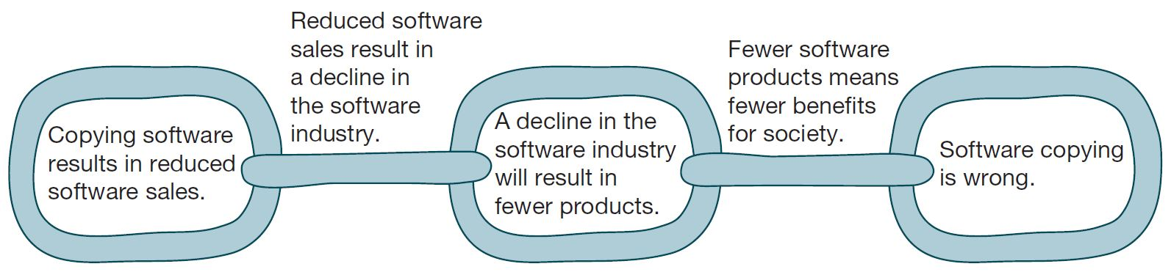
Argument Why Software Copying Is Bad
The chain of reasoning of a consequentialist argument for why copying software is bad. (Beth Anderson)

Slide 89
Utilitarian Analysis
Argument against copying
Copying software reduces software purchases…
Leading to less income for software makers…
Leading to lower production of new software…
Leading to fewer benefits to society
Each of these claims can be debated
Not all who get free copies can afford to buy software
Open-source movement demonstrates many people are willing to donate their software-writing skills
Hardware industry wants to stimulate software industry
Difficult to quantify how much society would be harmed if certain software packages not released

Slide 90
Conclusion
Natural rights argument weak
Utilitarian argument not strong, either
Nevertheless, society has granted copyright protection to owners of computer programs
Breaking the law is wrong unless there is a strong overriding moral obligation or consequence

Slide 91
4.9 Open-Source Software

Slide 92
Criticisms of Proprietary Software
Increasingly harsh measures being taken to enforce copyrights
Copyrights are not serving their purpose of promoting progress
It is wrong to allow someone to “own” a piece of intellectual property

Slide 93
Open-Source Definition
No restrictions preventing others from selling or giving away software
Source code included in distribution
No restrictions preventing others from modifying source code
No restrictions regarding how people can use software
Same rights apply to everyone receiving redistributions of the software (copy left)

Slide 94
Beneficial Consequences of Open-Source Software
Gives everyone opportunity to improve program
New versions of programs appear more frequently
Eliminates tension between obeying law and helping others
Programs belong to entire community
Shifts focus from manufacturing to service

Slide 95
Examples of Open-Source Software
B I N D
Apache
Sendmail
Android operating system for smartphones
Chrome and Firefox
OpenOffice.org
Perl, Python, Ruby, T C L/T K, P H P, Zope
G N U compilers: C, C++, Objective-C, Fortran, Java, Ada

Slide 96
G N U Project and Linux
G N U Project
Begun by Richard Stallman in 1984
Goal: Develop open-source, Unix-like operating system
Most components developed in late 1980s
Linux
Linus Torvalds wrote Unix-like kernel in 1991
Combined with G N U components to make an O.S.
Commonly called Linux

Slide 97
Impact of Open-Source Software
Linux an alternative to proprietary versions of Unix
Linux operating system on 97% of the world’s 500 fastest supercomputers (as of June 2014)

Slide 98
4.10 Creative Commons

Slide 99
Streamlining Creative Re-use
Under current copyright law, eligible works are copyrighted the moment they are created
No copyright notice does not mean it’s okay to copy
Must contact people before using work
That slows down creative re-use
Free Creative Commons license indicates
Which kinds of copying are okay
Which rights are being retained
Flickr has more than 250 million photos available under Creative Commons licenses

Slide 100
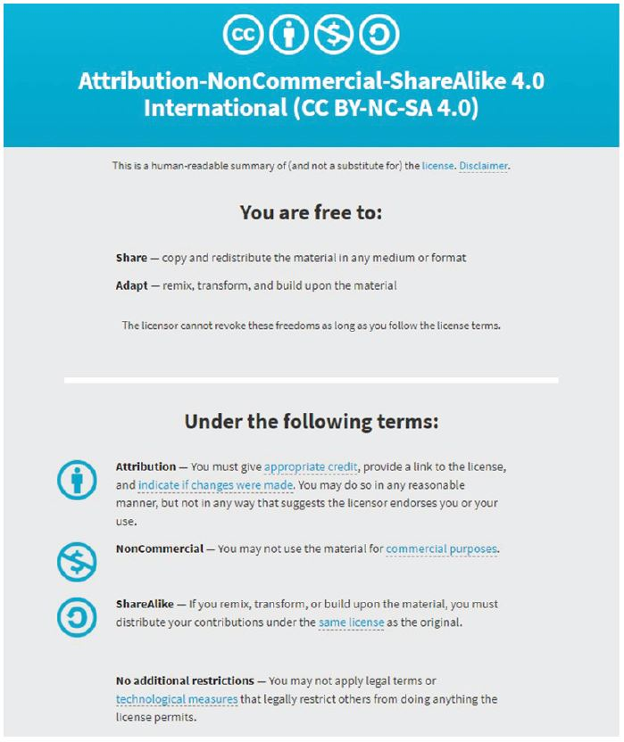
Creative Commons
Screenshot from Creative Commons. Copyright © 2018 by Creative Commons. Reprinted with permission.

Slide 101
Summary (1 of 3)
To stimulate creativity in the arts and technology, governments grant limited ownership rights to creators of intellectual property
Trade secrets
Trademarks/service marks
Patents
Copyrights
Goal: Provide creators of I P with rewards while ensuring public has access to their creations
Fair use doctrine an example of trying to find the balance between rights of I P holders and the common good
Time shifting
Space shifting

Slide 102
Summary (2 of 3)
New information technology has put pressure on I P laws
Digital representation of audio, video allows perfect copies
Broadband Internet allows quick and wide dissemination
Pirate Bay a prime example
Companies understand they must make “doing the right thing” as easy as “doing the wrong thing”
Now more convenient to get paid content through NetFlix, Hulu Plus, Apple iTunes store
Intellectual property rights for software
Copyright protection less controversial
Patent protection highly controversial
Alice v. C L S Bank may be a turning point

Slide 103
Summary (3 of 3)
Open-source movement
Alternative to proprietary model of software development
Success stories include Linux, Android, Firebox, and OpenOffice
Creative Commons
An effort to create a greater sharing culture in the arts
Allows copyright holders to indicate up front the conditions under which others can use their work

Slide 104

Copyright
This work is protected by United States copyright laws and is provided solely for the use of instructors in teaching their courses and assessing student learning. Dissemination or sale of any part of this work (including on the World Wide Web) will destroy the integrity of the work and is not permitted. The work and materials from it should never be made available to students except by instructors using the accompanying text in their classes. All recipients of this work are expected to abide by these restrictions and to honor the intended pedagogical purposes and the needs of other instructors who rely on these materials.

